Slide 1
Virtual Private Networks
Chapter 10

Slide 2
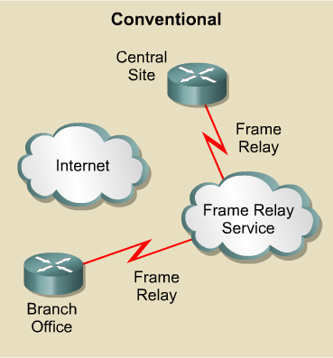
Conventional Private Networks
The advantage of using private networks such as frame relay, is it’s security.
However, the high costs, inflexible WAN technologies and complex topologies deter companies from using them.

Slide 3
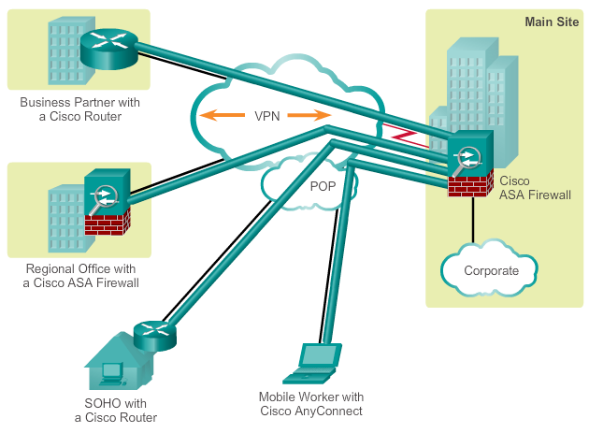
Virtual Private Networks
A Virtual Private Network (VPN) is a private network that is created via tunneling over a public network, usually the Internet.
VPNs have multiple benefits, including:
  Compatibility with different broadband technology
  Cost savings
  Security
  Scalability

Slide 4
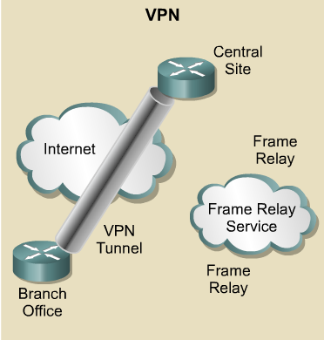
Virtual Private Networks
VPNs offer the same security advantage but for a lower cost, over the internet which caters for many flexible WAN technologies.
VPN services for network connectivity include:
  Authentication
  Data integrity
  Confidentiality

Slide 5
Two Types of VPNs
Site-to-Site VPNs:
  Intranet VPNs connect corporate headquarters, remote offices, and branch offices over a public infrastructure.
  Extranet VPNs link customers, suppliers, partners, or communities of interest to a corporate Intranet over a public infrastructure.
Remote Access VPNs:
  Which securely connect remote users, such as mobile users and telecommuters, to the enterprise.

Slide 6
Site to Site VPNs
There are 2 popular site-to-site tunneling protocols:
  Cisco Generic Routing Encapsulation (GRE)
  IP Security Protocol (IPsec)
When should you use GRE and / or IPsec?
IP Only?
User Traffic
Yes
No
Unicast Only?
Use IPsec VPN
Use GRE Tunnel
No
Yes

Slide 7

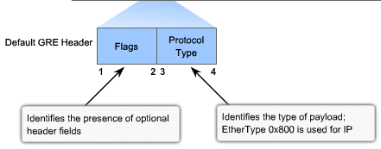
Generic Routing Encapsulation (GRE)
GRE can encapsulate almost any type of packet.
  Uses IP to create a virtual point-to-point link between Cisco routers
  Supports multiprotocol (IP, CLNS, …) and IP multicast tunneling (and therefore routing protocols)
  Best suited for site-to-site multiprotocol VPNs
GRE header adds 24 bytes of additional overhead

Slide 8
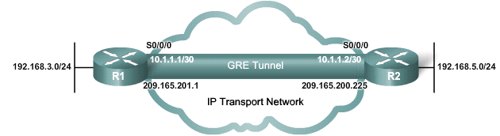
Five Steps to Configuring a GRE Tunnel
R1(config)# interface tunnel 0
R1(config–if)# ip address 10.1.1.1 255.255.255.252
R1(config–if)# tunnel source serial 0/0
R1(config–if)# tunnel destination 209.165.200.225
R1(config–if)# tunnel mode gre ip
R2(config)# interface tunnel 0
R2(config–if)# ip address 10.1.1.2 255.255.255.252
R2(config–if)# tunnel source serial 0/0
R2(config–if)# tunnel destination 209.165.201.1
R2(config–if)# tunnel mode gre ip

Slide 9
IPsec - Internet Protocol Security
A “framework” of open standards developed by the IETF to create a secure tunnel at the network (IP) layer.
  It spells out the rules for secure communications.
IPsec is not bound to any specific encryption or authentication algorithms, keying technology, or security algorithms.
IPsec allows newer and better algorithms to be implemented without patching the existing IPsec standards.

Slide 10
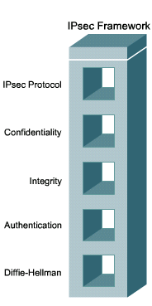
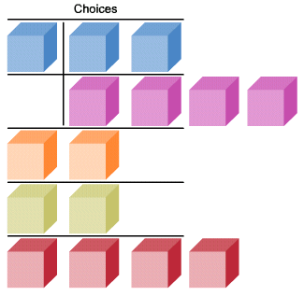
IPsec Protocol Framework
AH
ESP
ESP + AH
DES
3
DES
AES
SEAL
MD5
SHA
PSK
RSA
DH1
DH2
DH5
DH7

Slide 11
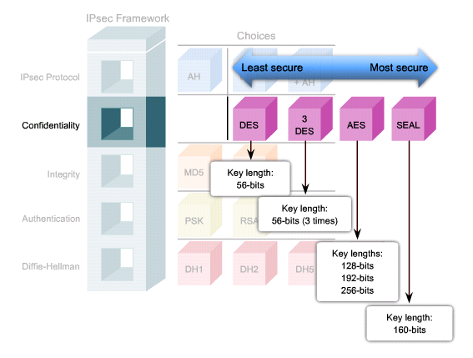
IPsec Confidentiality

Slide 12
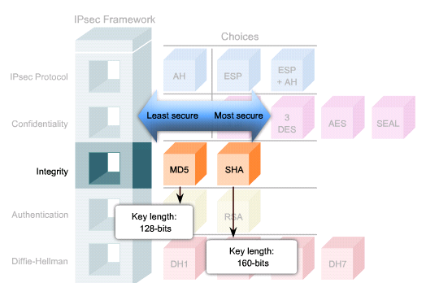
IPsec Integrity

Slide 13
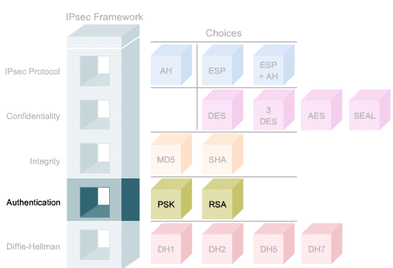
IPsec Authentication

Slide 14
Secure Key Exchange
AH
ESP
ESP + AH
DES
3
DES
AES
SEAL
MD5
SHA
PSK
RSA
DH1
DH2
DH5
DH7
768 bits
1024 bits
1536 bits
Used by DES and 3DES
Used by AES

Slide 15
IPsec Framework Protocols
IPsec uses two main protocols to create a security framework:
  AH: Authentication Header
  ESP: Encapsulating Security Payload

Slide 16
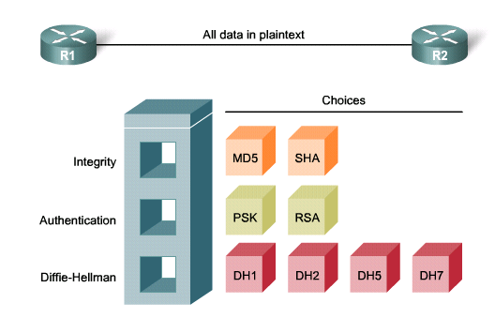
Authentication Header (AH)
provides authentication and optional replay-detection services using PSK or RSA.
  It supports DH Secure key exchange and operates on protocol number 51.
  supports integrity via hash verification using HMAC-MD5 and HMAC-SHA-1 algorithms.

Slide 17
Authentication Header (AH)
AH does not provide confidentiality (encryption).
  It is appropriate to use when confidentiality is not required or permitted.
  All text is transported unencrypted.
It only ensures the origin of the data and verifies that the data has not been modified during transit.(integrity assured)
If the AH protocol is used alone, it provides weak protection.

Slide 18
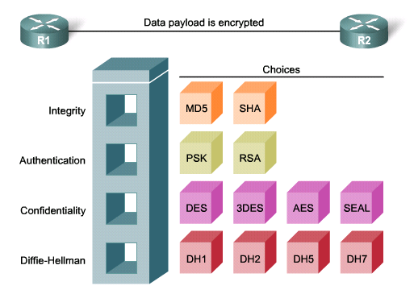
Encapsulating Security Payload (ESP)
ESP provides the same security services as AH (authentication and integrity) AND encryption service.
  It encapsulates the data to be protected.
  It operates on protocol number 50.

Slide 19
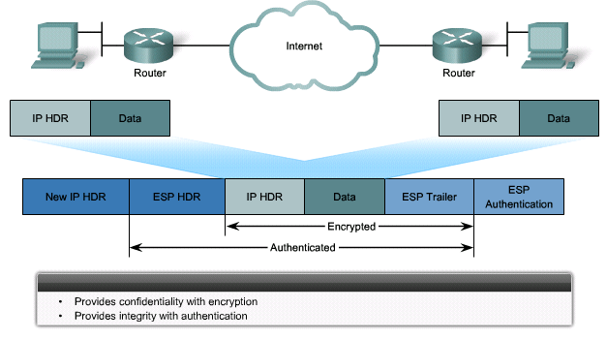
Encapsulating Security Payload (ESP)
ESP can also provide integrity and authentication.
  First, the payload is encrypted using DES (default), 3DES, AES, or SEAL.
  Next, the encrypted payload is hashed to provide data integrity using HMAC-MD5 or HMAC-SHA-1.

Slide 20

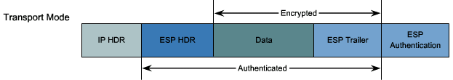
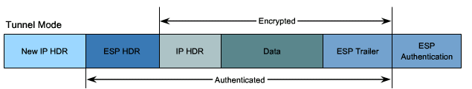
Transport Mode and Tunnel Mode
ESP and AH can be applied to IP packets in two different modes.

Slide 21
Transport Mode
Security is provided only for the Transport Layer and above.
  It protects the payload but leaves the original IP address in plaintext.
ESP transport mode is used between hosts.
Transport mode works well with GRE, because GRE hides the addresses of the end devices by adding its own IP.

Slide 22
Tunnel Mode
Tunnel mode provides security for the complete original IP packet.
  The original IP packet is encrypted and then it is encapsulated in another IP packet (IP-in-IP encryption).
ESP tunnel mode is used in remote access and site-to-site implementations.

Slide 23
How does IPsec work?

Slide 24
Understanding some terms
Internet Key Exchange
Security Associations

Slide 25
IKE - Internet Key Exchange
IKE helps IPsec securely exchange cryptographic keys between distant devices.
Key Management can be preconfigured with Internet Security Association and Key Management Protocol(ISAKMP) or with a manual key configuration.
  IKE and ISAKMP are often used interchangeably.
The IKE tunnel protects the SA negotiations.
  After the SAs are in place, IPsec protects the data that the devices exchange.

Slide 26
IKE - Internet Key Exchange
There are two phases in every IKE negotiation
Phase 1
  Authenticates and protects the identities of the IPSec peers
  Negotiates a matching IKE SA policy between peers to protect the IKE exchange
  Performs an authenticated Diffie-Hellman exchange with the end result of having matching shared secret keys
  Sets up a secure tunnel to negotiate IKE phase 2 parameters
  IKE Phase 1 negotiation can occur in, Main Mode & Aggressive mode. The difference between the two is that Main mode requires the exchange of 6 messages while Aggressive mode requires only 3 exchanges.

Slide 27
IKE - Internet Key Exchange
There are two phases in every IKE negotiation
Phase 2
  Negotiates IPSec SA parameters protected by an existing IKE SA
  Establishes IPSec security associations
  Periodically renegotiates IPSec SAs to ensure security
  Optionally performs an additional Diffie-Hellman exchange

Slide 28
Security Associations (SAs)
SAs is a relationship between the sender and a receiver that describes how the peers will use IPsec security services to protect network traffic.
SAs contain all the security parameters needed to securely transport packets between the peers or hosts.
SA can be identified by 3 parameters:
  Security Parameter Index (SPI)- is a number to identify the an SA
  IP Destination Address- the address of the destination device
  Security Protocol: AH or ESP

Slide 29
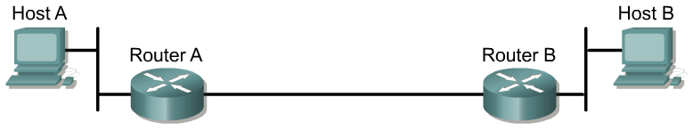



Five Steps of IPsec Transmission
Step 1
Host A sends interesting traffic destined for Host B.
Step 2
IKE Phase 1 authenticates IPsec peers and negotiates IKE SAs to create a secure communications channel for negotiating IPsec SAs in Phase 2.
Step 3
IKE Phase 2 negotiates IPsec SA parameters and creates matching IPsec SAs in the peers to protect data and messages exchanged between endpoints.
Step 4
Data transfer occurs between IPsec peers based on the IPsec parameters and keys stored in the SA database.
Step 5
IPsec tunnel termination occurs by SAs through deletion or by timing out.

Slide 30
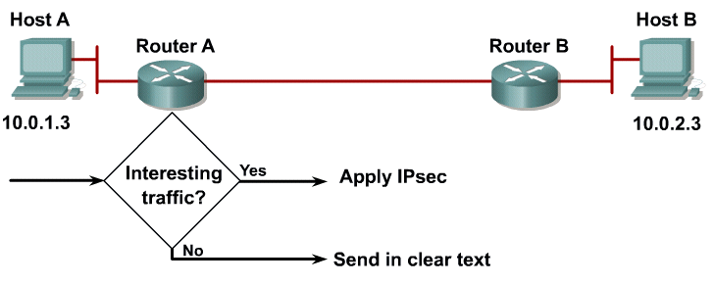
Step 1 – Interesting Traffic
Define interesting traffic with the use of ACLs

Slide 31
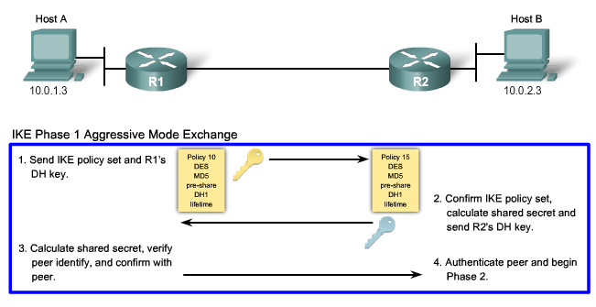
Step 2- IKE Phase 1

Slide 32
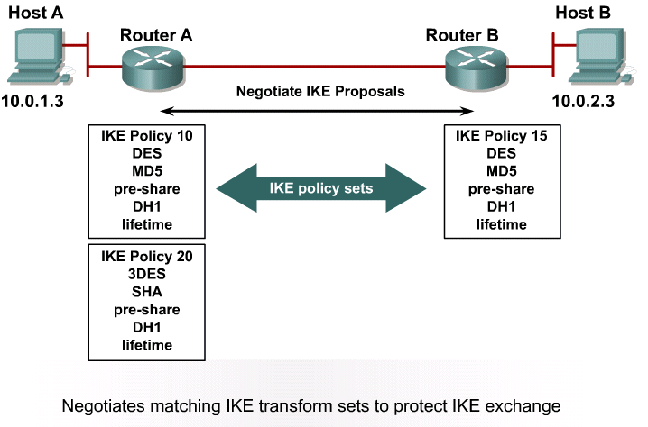
Step 2- IKE Phase 1
A router may have many different IKE policies. In order to successfully negotiate IKE phase 1, the policy sets must match.

Slide 33
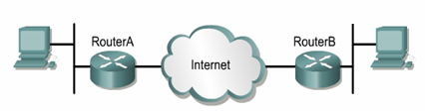
Step 2 – IKE Phase 1
DH Key Exchange
RouterA randomly chooses a string and sends it to RouterB.
RouterB hashes the received string together with the pre-shared secret and yields a hash value.
RouterA calculates its own hash of the random string, together with the pre-shared secret, and matches it with the received result from the other peer.
If they match, RouterB knows the pre-shared secret, and is considered authenticated.
RouterB sends the result of hashing back to RouterA.

Slide 34
Step 2 – IKE Phase 1
DH Key Exchange
RouterA also hashes the received string together with the pre-shared secret and yields a hash value.
Now RouterB randomly chooses a different random string and sends it to RouterA.
RouterB calculates its own hash of the random string, together with the pre-shared secret, and matches it with the received result from the other peer.
If they match, RouterA knows the pre-shared secret, and is considered authenticated.
RouterA sends the result of hashing back to RouterB.

Slide 35
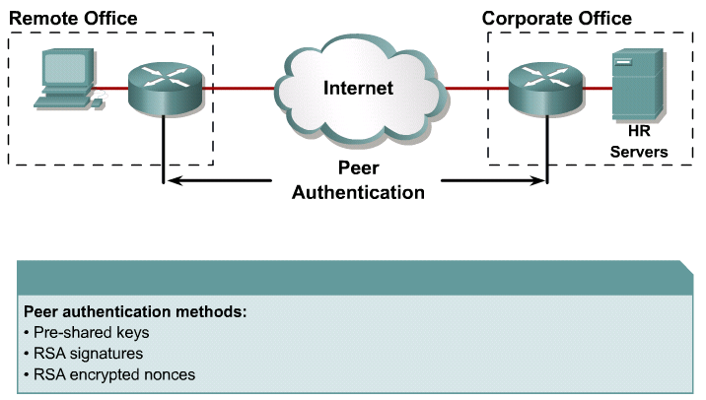
Step 2 – IKE Phase 1
Peer Authentication

Slide 36
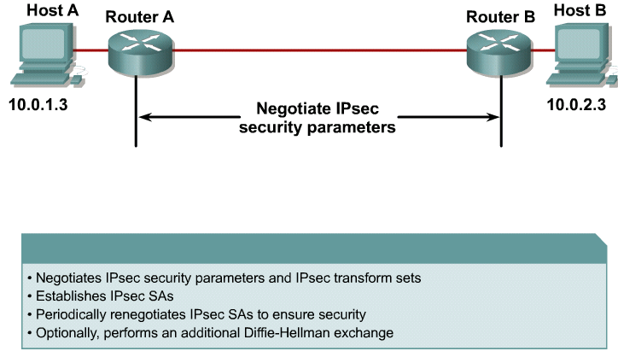
Step 3 – IKE Phase 2
IPsec Negotiation

Slide 37
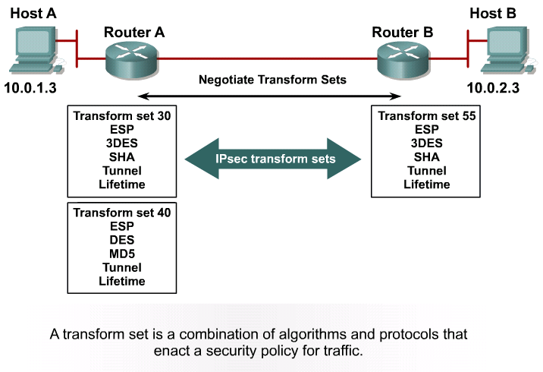
Step 3 – IKE Phase 2
Each router may have many transform sets. There has to be a matching Transform Set for a successful IKE Phase 2 negotiation.

Slide 38
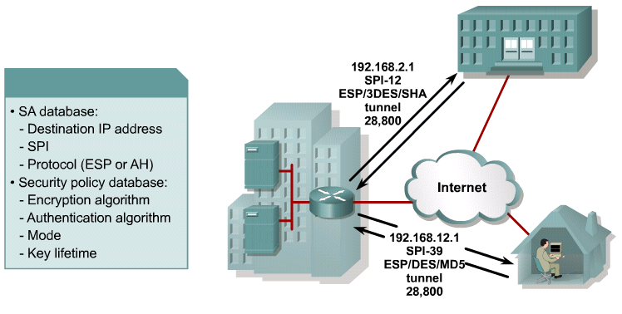
Step 3 – IKE Phase 2
Security Associations

Slide 39
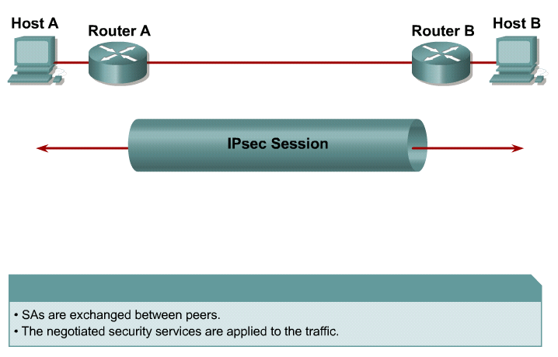
Step 4- Data Transfer
IPsec Session will then use the negotiated security parameters from IKE Phase 2 on the data traffic.

Slide 40
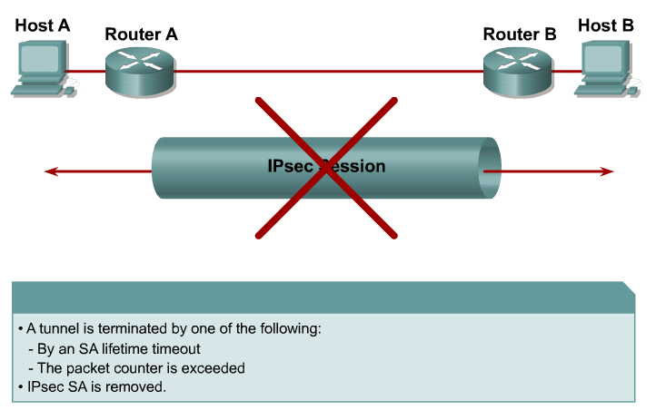
Step 5- Termination
Tunnel Termination

Slide 41
Watch Video:
IPSec VPN https://www.youtube.com/watch?v=rwu8__GG_rw
Read Article: http://www.ciscopress.com/articles/article.asp?p=25474&seqNum=7
SSL vs IP Sec VPNs difference https://www.youtube.com/watch?v=F9Jt14PWm3U
Extra Resources

Slide 42
The End

